Slide 1
Remote Procedure Calls
Sending bytes between processes is a primitive ability and most applications need more than this
This forces applications to define protocols to define meaning for the byte streams
This effort can be saved if a useful protocol is defined in advance

Slide 2
Remote Procedure Calls
The remote procedure call provides a pre-defined protocol that exactly matches the method calls of a programming language
RPC
Allows a method on one computer to invoke a method on another computer
Parameters can be transmitted and results returned
The developer is barely aware that the procedure being invoked is not in the local process memory

Slide 3
The RPC Landscape
RMI
Java Remote Method Invocation
Java only
CORBA
Common Object Request Broker
Language independent
SOAP
Simple Object Access Protocol
Language independent
.NET Remoting
.NET native RPC
.NET only at the moment

Slide 4
Proxies
A proxy is something which stands in place of something else
In RPC, proxies are used to represent remote objects
A proxy must
Implement the same interface as the remote object
Implement each method to package the method call, send it across a network, and return the response
It must do this transparently

Slide 5
Proxies
Remote Interface
implements
Proxy
Sink
Local Class
Remote
Object
Method
call
Serialized Data
Network
Method
call
A proxy has the same interface as the remote object
It turns a method call into serialized data and sends the data across the net to the remote object

Slide 6
Marshaling by Value
Objects cannot just be sent across a network
They must be turned into a data stream for transmission
The data stream consists of
The class or type of the object
The types of the fields
The data in the fields

Slide 7
Marshaling by Value
When method parameters are sent across a network, they are usually serialized
Serialization turns a primitive or object into a data stream which can be transmitted across a serial connection
Deserialization at the receiving end can turn the serialized stream back into an object with the same values as the original

Slide 8
Marshaling by Reference
Marshaling by value sends a copy of an object across a network
There is another way to access an object across a network – marshal by reference
Marshall by reference sends a proxy for the object across the net
This looks like the real object, but it makes network calls to the real object when you ask it to do anything

Slide 9
Transmission Protocols
At present, remoting supports two protocols
HTTP
The data is serialized into a textual format called the Simple Object Access Protocol and transmitted via the web
The advantage is that many companies close all ports except port 80 for security reasons and this might be the only way to transport requests

Slide 10
Transmission Protocols
TCP/IP
This serializes into a binary stream transported over TCP/IP sockets
It requires the use of ports other than 80
Since the stream is binary, it is more compact and efficient than the textual stream used by SOAP

Slide 11
Simple Object Access Protocol
SOAP is a textual form of RPC
It represents all the information for a remote procedure call as an XML document
Any objects which have to be passed are also represented as XML documents
SOAP is a surprisingly complex format

Slide 12
Clients and Servers
Remote objects listen for requests from clients in the form of method calls
In this way, a remote object acts as a server and the program calling the remote method is the client
In many cases, one remote object will call another and they will alternately become clients and servers as the exchange continues

Slide 13
Publishing
How do you find a remote object?
When a remote object is created, it publishes its location in a directory
It selects a name and binds its internet address and proxy to the name
The client then asks the server for the remote object and is given a proxy for the object

Slide 14
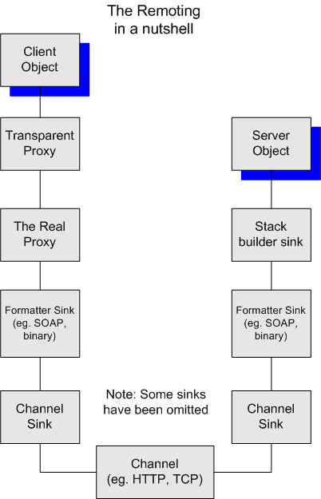
* Daniel Meng

Slide 15
Remoting Components
Proxies
Have the same interface as a remote object
Marshal the calls and transmit them across a network
Transparent proxy
This presents the remote interface and is what is called by the client
Real proxy
This is called by the transparent proxy and marshals the data

Slide 16
Remoting Components
Formatters
Translates an object into its serialized form
Sinks
These are components which process the messages
They are in a chain which can be extended
They can
Enforce security
Act as formatters
Encrypt the messages

Slide 17
Remoting Components
Channels
The channel is the part that is responsible for the transport of the messages
This is either an HTTP channel or a TCP/IP channel
Custom Sinks
You can create custom sinks to do additional processing of the messages

Slide 18
Remote Object Lifetime
When you create a remote object you can select between
Single Call
Every call to the object generates a new instance of the object which handles the request and then dies
This is suitable if each call should have its own data and should have no memory of any other calls
This makes the remote object stateless

Slide 19
Remote Object Lifetime
Singleton
If you select this, then all calls to the remote object are handled by the same object
There is only a single copy of the object
Data can be stored in the object and it will be available to the next call to the object
This makes the object stateful

Slide 20
Example: Remote Phone Directory
We will now look at a simple example of a remote phone directory consisting of
PhoneDirectory
A remote object acting as a directory
PhoneInfo
A serializable class used to return the phone information on a person
Client
A command line application which looks up phone information and displays the results

Slide 21
Step 1: Interfaces
First, create an interface for the remote object
public interface IPhoneDirectory
{
PhoneInfo GetPhoneInfo(string name);
}

Slide 22
Step 1: Interfaces
You might also want to make an interface for the serializable classes
public interface IPhoneInfo
{
string Name { get;}
string Address { get;}
string Phone { get;}
string ToString();
}

Slide 23
Step 2: Remote Object
This must be accessed by reference
Therefore, it must extend MarshalByRefObject
class PhoneDirectory : MarshalByRefObject, IPhoneDirectory
{
Hashtable phoneTable = new Hashtable();
…
}

Slide 24
Step 2: Remote Object
The constructor fills the phone dir
public PhoneDirectory()
{
phoneTable["Fred"] = new PhoneInfo("Fred Flintstone", "99 Granite Way", "416-238-4387");
phoneTable["Wilma"] = new PhoneInfo("Wilma Flintstone", "99 Granite Way", "416-238-4387");
phoneTable["Barney"] = new PhoneInfo("Barney Rubble", "97 Granite Way", "416-238-4343");
phoneTable["Betty"] = new PhoneInfo("Betty Rubble", "97 Granite Way", "416-238-4343");
phoneTable["Bam Bam"] = new PhoneInfo("Bam Bam Flintstone", "99 Granite Way", "416-238-4387");
}

Slide 25
Step 2: Remote Object
Finally, we have the method to return a phone entry
public PhoneInfo GetPhoneInfo(String name)
{
return (PhoneInfo)phoneTable[name];
}

Slide 26
Step 3: Serializable Data
Now, we make the PhoneInfo class serializable
[Serializable]
public class PhoneInfo
{
String _name;
String _address;
String _phoneNumber;
public PhoneInfo(string nm, string adr, string ph)
{
_name = nm;
_address = adr;
_phoneNumber = ph;
}
…
}

Slide 27
Step 4: Create a Server
This is a Main method to create and publish the remote object
static void Main(string[] args)
{
TcpServerChannel channel = new TcpServerChannel(9999);
ChannelServices.RegisterChannel(channel, false);
RemotingConfiguration.RegisterWellKnownServiceType(
typeof (PhoneDirectory), "PhoneDirectory",
WellKnownObjectMode.Singleton);
…
}

Slide 28
Step 4: Create a Server
Create channel on port 9999
TcpServerChannel channel = new TcpServerChannel(9999);
Register channel without security
ChannelServices.RegisterChannel(channel, false);
Create the remote object
RemotingConfiguration.RegisterWellKnownServiceType(typeof (PhoneDirectory), "PhoneDirectory",
WellKnownObjectMode.Singleton);

Slide 29
Step 5: Create a Client
Create a channel
ChannelServices.RegisterChannel(new TcpClientChannel(), false);
Locate remote object
IPhoneDirectory phoneDir =
(IPhoneDirectory)Activator.GetObject(
typeof(IPhoneDirectory),
"tcp://localhost:9999/PhoneDirectory");
Invoke a method
PhoneInfo info = phoneDir.GetPhoneInfo(“Fred”);
* see remote_demo, remote_demo_client

